Slide 1
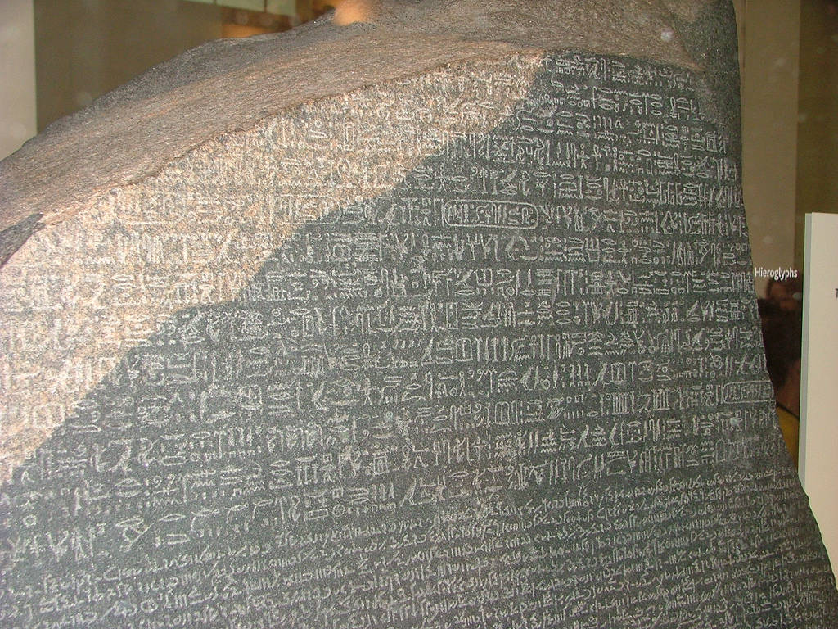
The Rosetta Stone

Slide 2
What is the Rosetta Stone?
The Rosetta Stone is a stone with writing on it.
It was created in 196 BC.

Slide 3
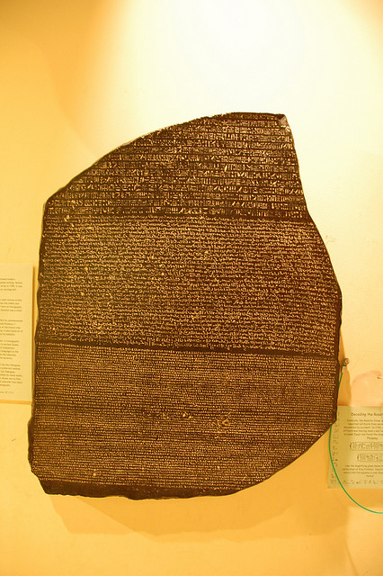
How big is the Rosetta Stone?

Slide 4
How big is the Rosetta Stone?
The stone is 45 inches high.
It is 28 inches wide.
11 inches thick.
It weighs approximately 1,676 lb.

Slide 5
Why is it called the Rosetta Stone?
The Rosetta Stone is named after the town it was discovered in, a town called Rosetta, on the Mediterranean coast in Egypt.

Slide 6
What does the Rosetta Stone say?
The Rosetta Stone is thought to have been written by a groups of priests in Egypt to honor the Egyptian Pharaoh. It lists all of the good things that the pharaoh has done for the priests and the people of Egypt.

Slide 7
When was the Rosetta Stone found
The Rosetta Stone was found in 1799.

Slide 8
Who found the Rosetta Stone?
The Rosetta Stone was found by French soldiers in 1799 by Napoleon’s troops.
It was brought to the British Museum in 1801.
Thomas Young and Jean Francois Champollion helped to decode this magnificent artifact.

Slide 9
How long did it take to decode the Rosetta Stone?
For twenty years scholars tried to decode the slab.

