Slide 1
The making of Egyptian Papyrus
Papyrus Paper

Slide 2
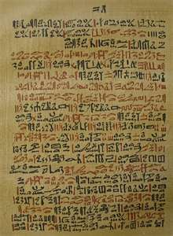
Long before there were textbooks, newspaper, or email, the Egyptians came up with a way to record history.

Slide 3
They designed their own paper called Papyrus from reeds.
The word ‘paper’ comes from the Egyptian word Papyrus, which means “that which belongs to the house.”

Slide 4
Where does Papyrus come from?
Papyrus is made from a plant that grows on the banks of the Nile River in Egypt.
The reeds grow up to 15ft.
The leaves are very sharp and flower at the top.

Slide 5
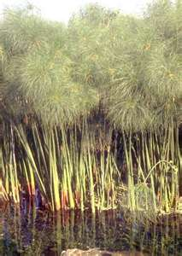
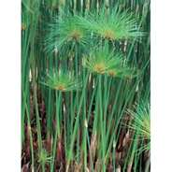
The Papyrus plant

Slide 6
How is Papyrus Made?
The outside layer of the stem was removed.
The inner layer of the plant was sliced into long strips and placed side by side.
A second layer was placed horizontally over the strips that were placed side by side.
The layers were soaked in water and pressed under a heavy rock for 21 days.

Slide 7
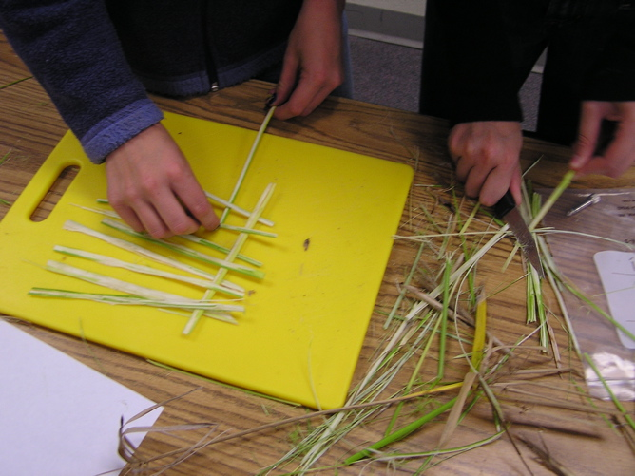
Making Papyrus

Slide 8
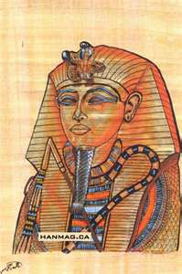
The juice of the plant acted like glue and bonded the strips together.
After the 21 days they would dry the paper out and hammer it flat.
The rest is history.

