Slide 1
Masks
Artifacts of a fading but not forgotten civilizations.

Slide 2
What is the meaning behind the mask?
Browse through the gallery of masks in the following slides.
Ask yourself, Do I see a meaning/connection to “something” that gives me insight to this culture’s life?
Read the meaning for each mask on the following slide; there are a couple of masks that do not have a meaning attached.

Slide 3
Respond in your journal
Respond in your journal to 4 masks presented in the gallery.
Think about the design.
The colors used.
The shape of the mask
Any additional embellishments added to the m ask (hair, beads, ect..).
Date your journal and title your page: What is the meaning behind the mask?

Slide 4
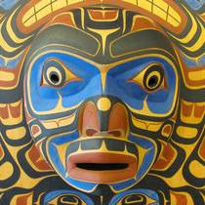
Kwagiulth Moon Mask with Killer Whales

Slide 5
Meaning of mask
This type of moon mask is not used in any specific dance during a potlatch, rather it is often used by the artist to tell a story or incorporate the moon with certain totems and mythical creatures. In this mask the moon is combined with the very powerful killer whale, which is a very important Sea creature in Northwest Coast Mythology. In the spirit world, the killer whale is often associated with powerful ancestors, as well as coppers, the symbol of great wealth. To many Kwagiulth People, great chiefs who have passed away will often transform into killer whales. The killer whale is usually identified by a blow hole on top of his head as well as his large dorsal fin and a mouth full of large teeth.

Slide 6
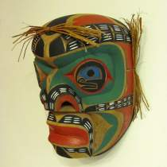
Ancestral Mask

Slide 7
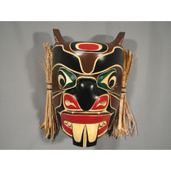
Beaver Mask

Slide 8
Meaning of mask
The Native Symbol or Totem Beaver: In Native American tradition, the Beaver teaches people to have the ability to be productive in all ways and not to limit their options. He teaches to be persistent and to use available resources. The Beaver helps people to understand the dynamics of team work and to appreciate each individual’s talents and contributions in order to accomplish anything. He is a determined, builder of the mind, body and soul and symbolizes creativity, creation, cooperation, persistence and harmony. The Beaver also is a serious, hard worker and will not quit his job until he is done.

Slide 9
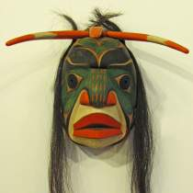
Chief of the Undersea People

Slide 10
Meaning of mask
Komokwa means “Wealthy One” and is the mythical King of the Supernatural Undersea World. He is also called the Copper Maker.
The King or Guardian of the Sea is a very powerful and wealthy ruler who lives in a great House made of copper under the sea, filled with food and treasures. It is said that he is the master and protector of the seals and has live sea lions as house posts that guard the entrance.
As the King of the Undersea World many of the sea creators like octopods, killer whales, loons, seals, sea lions, and sculpins are closely associated with him. You will very often find representations of these creators attached to the image of Komokwa.

Slide 11
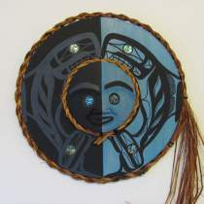
The Orca or Killer Whale

Slide 12
Meaning of mask
The Native Symbol Orca or Killer Whales symbolizes family, romance, longevity, harmony, travel, community and protection. He is said to protect those who travel away from home, and lead them back when the time comes. The Killer Whales live like wolves, mate for life and raise each child with care. They also travel in large groups of families, working together to protect all members of their pod.
Known as the “Lord of the Ocean” the Killer whale is said to be the guardian of the ocean, with seals as his slaves and dolphins as his warriors. It is believed that Killer Whales are closely related to humans, and it is said that when a human drowns the human is taken down by Killer Whales into their deep villages and transformed into a Killer Whale. Some tribes believe that the Killer Whale will purposefully take down whole canoes to come closer to their loved ones.

Slide 13
When a Killer Whale is seen of shore he is believed to be a deceased human or chief trying to communicate with loved ones. Some tribes believe that Orcas are reincarnations of their former chiefs lost at sea. Some people tell the following story on how the white markings appeared on the Killer Whale. As a legend describes, a Killer Whale fell in love with an Osprey. The Killer Whale was so in love that he would jump out of the water and into the air, to be closer to the Osprey. The Osprey would respond by flying lower to meet the whale. They had a child together and the child was born black like the Whale with white markings from the Osprey.

Slide 14
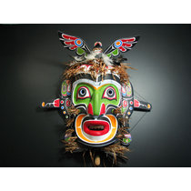
King of the Undersea World Mask

Slide 15
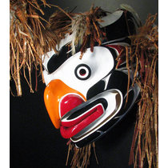
Grouse Mask

Slide 16
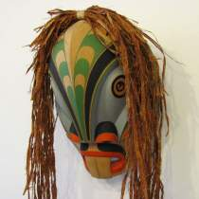
Kwaguilth Merman Mask

Slide 17
Meaning of mask
In Kwaguilth Mythology the Merman is an undersea spirit in human form.

